Slide 1
SMART 3D PEN
Team Name :Matrix
College Name : Delhi Technological University
Participant Name 1 : Vipul Saini
Participant Name 2 : Vivek Singh Bhadauria

Slide 2
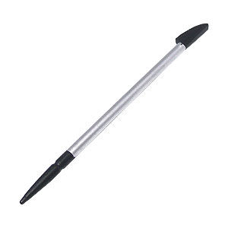
Brief Description of the Proposed Idea
Category of Idea : Hardware
A stylus pen that is able to recognize the spatial movement of its tip and transfer the content into the users smartphone.

Slide 3
Brief Description of the Proposed Idea
Features:
Enable users to write in their own handwriting and draw any kind of shape on any surface fast and naturally.
Enable designers and engineers to capture 3d shapes and store their dimensions easily.

Slide 4
Market / Consumer Trends & Gaps which this idea targets to fulfill
Change the conventional way of making notes.
Collaborative working techniques.
The idea of having paperless society.

Slide 5
Executional Details
System consists of a inertial measurement unit(IMU) i.e. MPU-9250, delivered in a 3x3x1mm OFN package, which is the world’s smallest micro-electro-mechanical-system(MEMS) 9-axis Motion Tracking device from InvenSense Technology.
Raw sensor data from accelerometer, gyroscope and magnetometer inside MPU-9250 is extracted by any ARM cortex M-4 microcontroller using I2C bus.
Now this raw data is converted to useful information(roll, pitch, yaw and position) using our special algorithm.

Slide 6
Executional Details
The correct moment to store and render these values would be determined by the accelerometer readings and pressure reading from the tactile pressure sensor integrated inside the tip and on the gripping area.
The locus of the required positional values gives nothing but the text/figures that the user has written/drawn.
Now this locus is transferred to the smartphone via Bluetooth where it is displayed and digitally stored for further applications.

Slide 7
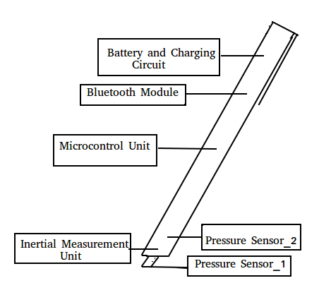
Executional Details
Layout Diagram
Major Parts Include:
InvenSense’s MPU-9250 as IMU sensor
TI TM4C123G as microcontroller unit(contains ARM cortex M4)
Any compatible Bluetooth module.

Slide 8
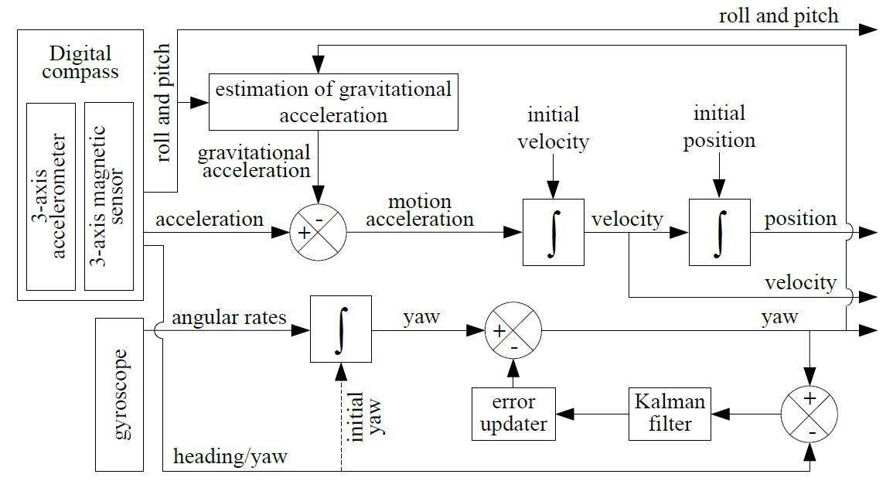
Executional Details
Algorithm
Flowchart

Slide 9
Commercial Details
For Single Unit:
TMS4C123G: 5.95$
MPU-9250:10.64$
Bluetooth + Battery module + Pressure sensors: 10$(approx.)
For large scale production the overall price may vary depending upon the number units and fabrication process.

Slide 10
Viability of the idea
Freedom of placement of IMU sensor.

Slide 11
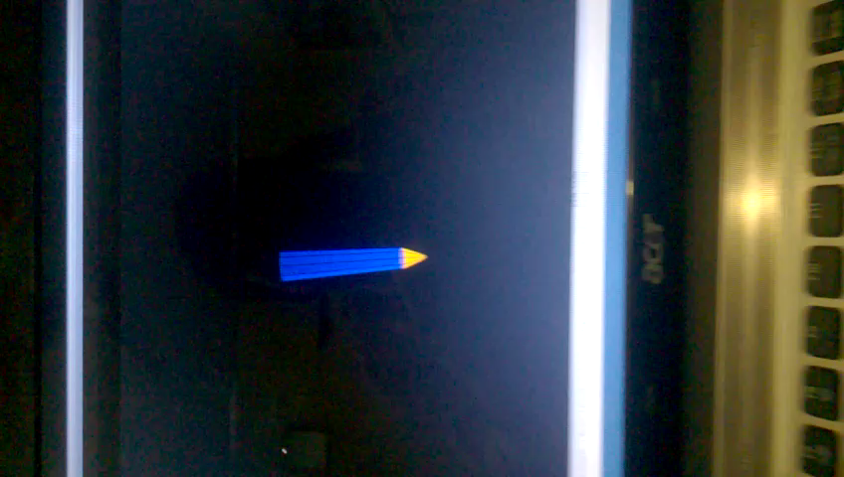

Slide 12
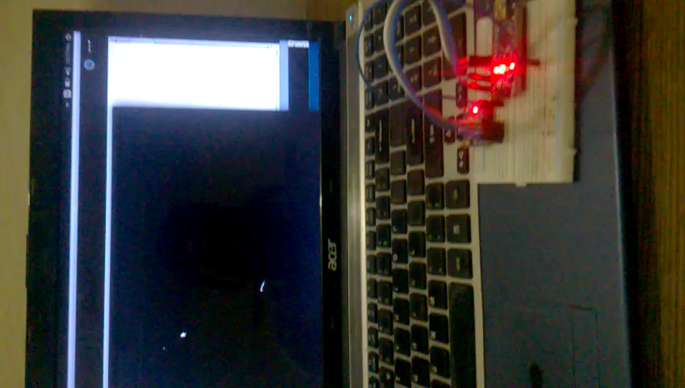

Slide 13
Viability of the idea
Smart rendering is possible with the help of different sensors in the pen.

Slide 14
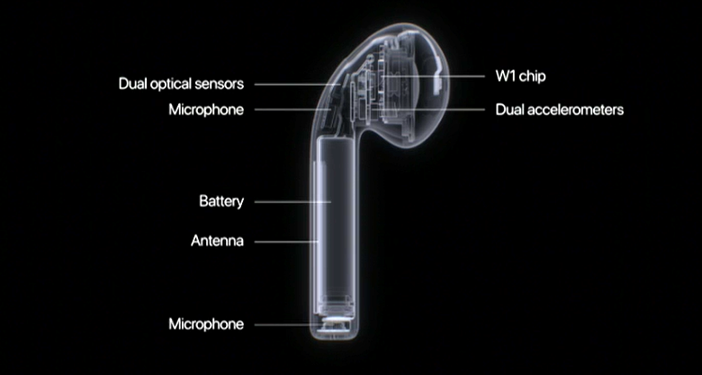
Viability of the idea
Integration of components.
We have a great example which shows that such level of integration of component is achievable.
Apple’s AirPods have battery life of 5hrs per charge and has similar component integration level as required in our idea.

Slide 15
Challenges & Constraints
Positional drift that the IMU sensor produces.
Acceptable form factor.

Slide 16
THANK YOU

